Slide 1
“INTRODUCTION OF SP”

Slide 2

CONTENTS :-
Introduction to Systems Programming
Need of Systems Programming
Software Hierarchy
Types of software: system software and application software.
Evolution of components of Systems Programming:
Text Editors
Assembler
Macros
Compiler
^{I}M^{n}R.^{t}A^{e}N^{r}A^{p}NDreG^{t}H^{e}AR^{r}U

Slide 3
CONTENTS :-
Evolution of components of Systems Programming: -
Loader
Linker
Debugger
Device Driver
Operating System.
Elements of Assembly Language Programming:
Machine structure
Assembly Language statements, Benefits of Assembly Language
A simple Assembly scheme, Pass Structure of

Slide 4
CONTENTS :-
Design of two pass Assembler:
Processing of declaration statements
Assembler Directives and imperative statements
Advanced Assembler Directives
Intermediate code forms
Pass I and Pass II of two pass Assembler.

Slide 5
CONTENTS :-
Sample videos :
Preprocessor :
https://youtu.be/JZkPEl8JjZo?list=PLhb7SOmGNUc6Fg7zmBOOS3y N2AG0JiREp
Compiler execution stages :
https://youtu.be/cJDRShqtTbk?list=PLhb7SOmGNUc6Fg7zmBOOS3y N2AG0JiREp

Slide 6
Introduction
Computer : A programmable device that can store, retrieve, and process data.(Combination of H/w & S/w )
Hardware : things which we can touch.
Software : things which we cannt touch.(Can only see)
Programming: A programming language is a set of commands, instructions, and other syntax use to create a software program.
Data : Information in a form a computer can use
Information : Any knowledge that can be communicated

Slide 7
Introduction
Computer program : Data type specifications and instructions for carrying out operations that are used by a computer to solve a problem.
Machine language : The language, made up of binarycoded instructions, that is used directly by the computer
Assembly language : A low-level programming language in which a mnemonic is used to represent each of the machine language instructions for a particular computer

Slide 8
Introduction
Source code : Program or set of instructions written in a high-level programming language
Object code : A machine language version of source code.
Target code : program output in Machine code (binary form)
,

Slide 9
Introduction
Preprocessor :
a preprocessor is a program that processes its input data to produce output that is used as input to another program.
Editor : A text editor is a type of computer program that edits plain text. Such programs are sometimes known as "notepad" software
Compiler : A program that translates a program written in a high- level language into machine code
Assembler : A program that translates an assembly language program into machine code

Slide 10

Introduction
Loader:-
A loader is a program used by an operating system to load programs from a
secondary to main memory so as to be executed.
Linker :
a linker is a computer program that takes one or more object files generated by a compiler and combines them into one, executable program
Debugger :
Debugger is program which is used to test program or execute program in single step execution.

Slide 11
Introduction
What is System?
System is the collection of various components
Ex:- College is a system.
College is a system because it consist of various components like various departments, classrooms, faculties and students.
What is Programming?
Art of designing and implementing the programs.

Slide 12
Introduction
What is System Programming?
Systems programming involves the development of the individual pieces of software that allow the entire system to function as a single unit.
Systems programming involves many layers such as the operating system (OS), firmware, and the development environment.

Slide 13
Introduction
In college system, what is program?
A LECTURE can be a program. Because it has input and output.
Input-> The information that teacher is delivering.
Output-> The knowledge student has been received.
So system programming is an art of designing and implementing SP

Slide 14
Need of System Programming
System programs provide an environment where programs can be developed and executed.
In the simplest sense, system programs also provide a bridge between the user interface and system calls.
In reality, they are much more complex. For example, a compiler is a complex system program.

Slide 15
Need of System Programming
The system program serves as a part of the operating system. It traditionally lies between the user interface and the system calls.
The user view of the system is actually defined by system programs and not system calls because that is what they interact with and system programs are closer to the user interface.

Slide 16
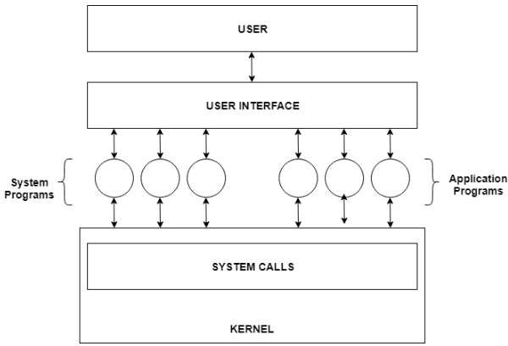
Need of System Programming

Slide 17
Need of System Programming
In the above image, system programs as well as application programs form a bridge between the user interface and the system calls. So, from the user view the operating system observed is actually the system programs and not the system calls

Slide 18
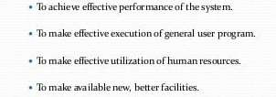
Need of System Programming

Slide 19
Software Hierarchy
A software hierarchy is the combination of product, version, and release (or feature) that represents an item of software in a database or knowledge base. The product is the root of the hierarchy.
Software
System Software
Operating System
System Support
System Development
2. Application Software
· General Purpose
· Application Specific

Slide 20
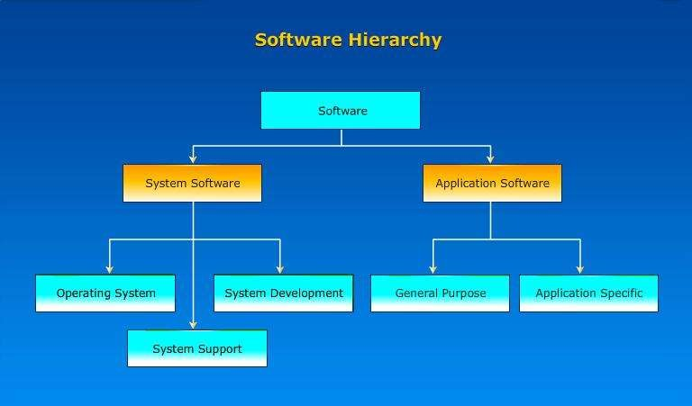
Software Hierarchy

Slide 21
What is Software ?
Software is collection of many programs
Two types of software
–System software: These programs assist general user application programs
Ex:- Operating System , Assembler etc.
– Application software
These are the software developed for the specific goal.
Ex. Media Player, etc

Slide 22
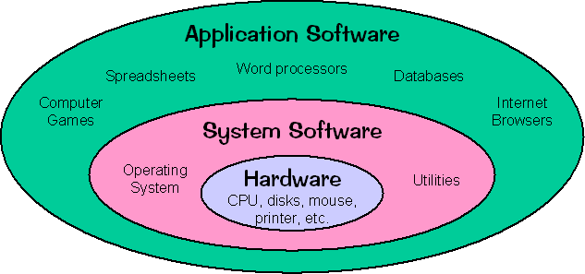
System software Vs Application software

Slide 23
System software Vs Application software
Sr. No | System Software | Application Software
1. | System software is used for operating computer hardware. | Application software is used by user to perform specific task.
2. | System softwares are installed on the computer when operating system is installed. | Application softwares are installed according to user’s requirements.
3. | In general, the user does not interact with system software because it works in the background. | In general, the user interacts with application sofwares.
4. | System software can run independently. It provides platform for running application softwares. | Application software can’t run independently. They can’t run without the presence of system software.
5. | Some examples of system softwares are compiler, assembler | Some examples of application softwares are word processor, web browser

Slide 24
System software Vs Application software
Sr. No | System Software | Application Software
1. | It is general purpose software | It is specific purpose software
2. | Written in low level language | Written in High level language
3. | Small in size | Large in size
4. | Complex to design and implement | Easy to design and implement
5. | Some examples of system softwares are compiler, assembler, debugger, driver, etc. | Some examples of application softwares are word processor, web browser, media

Slide 25

System Programming Components
- Text Editors
Assembler
Macros
Compiler
Interpreter
Loader
Linker
Debugger
Device Driver
Operating System.

Slide 26
Text Editors
Editor is a computer program that allows a user to create and revise a document..
A text editor is a type of program used for editing plain text files.
With the help of text editor you can write your program(e.g. C Program or Java Program).
Text editor’s example is Notepad.

Slide 27
Types of Text Editors
Line editor : This code editor edits the file line by line. You cannot work on a stream of lines using the line editor. Example of a line editor is teleprinter.
Stream editor : In this type of editors, the file is treated as continuous flow or sequence of characters instead of line numbers, which means here you can type paragraphs.
Ex : Sed editor in UNIX

Slide 28
Types of Text Editors
Screen editors : In this type of editors, the user is able to see the cursor on the screen and can make a copy, cut, paste operation easily. It is very easy to use mouse pointer.
Ex : vi, emacs, Notepad
Word Processor : Overcoming the limitations of screen editors, it allows one to use some format to insert images, files, videos, use font, size, style features. It majorly focuses on Natural language.

Slide 29
Loaders
A loader is a program that takes object code as input and prepares them for execution.
It initiates the execution.
Functions:
Allocation
Linking
Relocation
4. Loading

Slide 30
Functions of Loader
Allocation : Loader allocates space for programs in main memory
Linking- which combines two or more separate object programs (by Linker)
Relocation - which modifies the object program so that it can be loaded at an address different from the location originally specified - (Linking Loader) and data into main memory
Loading - which allocates memory location and brings the object program - (Loader)

Slide 31
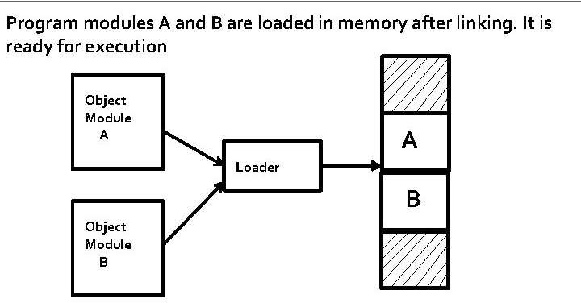
GENERAL LOADING SCHEME

Slide 32
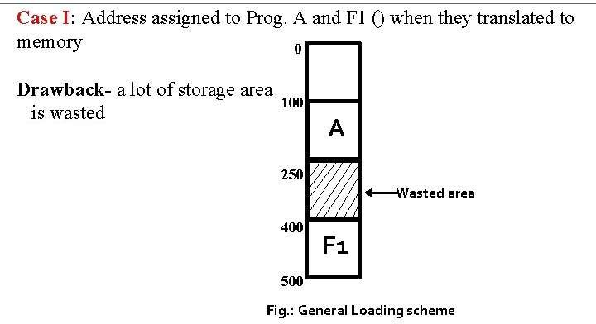
RELOCATION

Slide 33
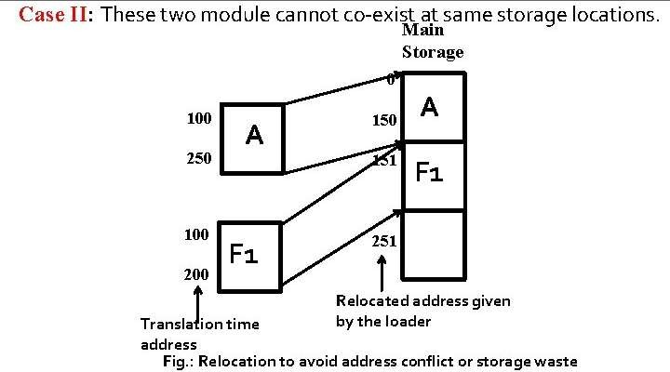
RELOCATION

Slide 34
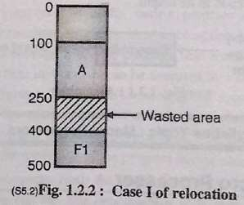
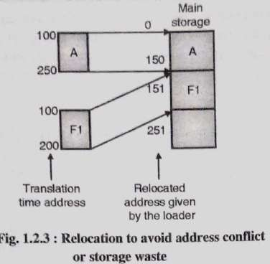
RELOCATION

Slide 35
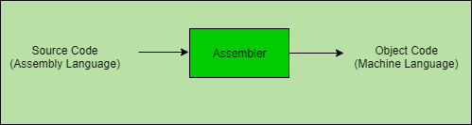
Assembler
Assembler assembly language.
is a translator which
translates machine
language program into

Slide 36
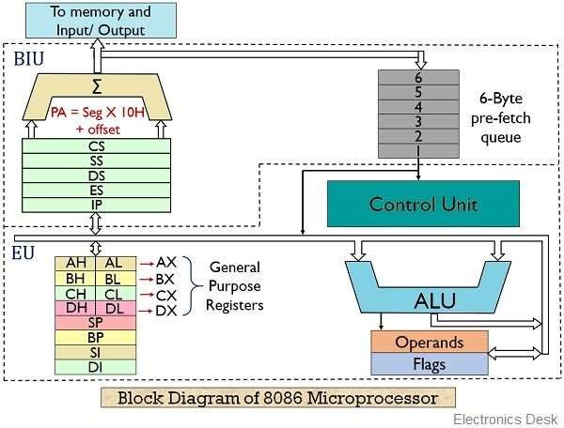
Microprocessor

Slide 37
Macro & Macroprocessor
Macro allows a sequence of source language code to be defined once and then referred many times.
“ A macro is a sequence of instructions, assigned by a name and could be used anywhere in the program ”
In NASM, macros are defined with %macro and %endmacro directives.
The macro begins with the %macro directive and ends with the
%endmacro directive.
Syntax:
%macro macro_name number_of_params
<macro body>
%endmacro

Slide 38
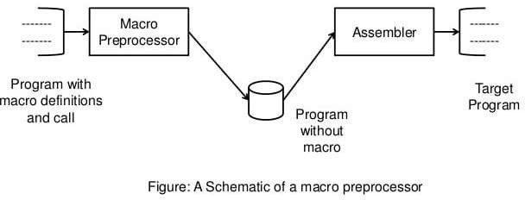
Macro & Macroprocessor
A macro processor takes a source with macro definition and macro calls and replaces each macro call with its body.

Slide 39
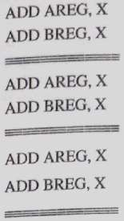
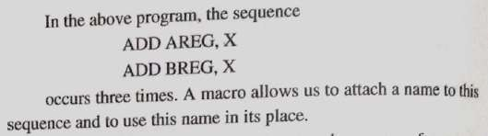
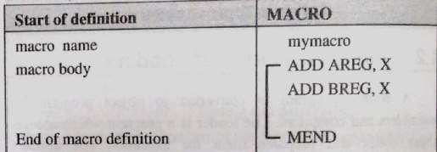
Macro & Macroprocessor
How Macroprocessor works :

Slide 40
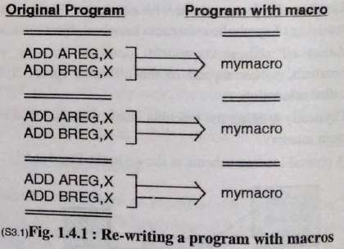
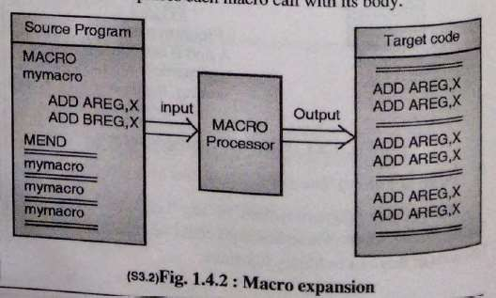

Slide 41




PREPROCESSORS,COMPILERS, ASSEMBLERS, AND LINKERS
Skeletal Source Program
Preprocessor
Try for
gcc myprog.c
Compiler
example:
Assembler
Target Assembly
Program Relocatable Object
Libraries and Relocatable Object Files
Linker
Code
Absolute Machine Code
42

Slide 42
Compiler
Compiler is a translator which converts the high level language into low level language.
Benefits of writing a program in a high level language :
Increases productivity: It is very easy to write a program in a high level language.
Machine Independence:

Slide 43









COMPILERS
“Compilation”
– Translation of a program written in a source language into a semantically equivalent program written in atarget language
Input
Source Progra m
Target Program
Compiler
Output
3

Slide 44
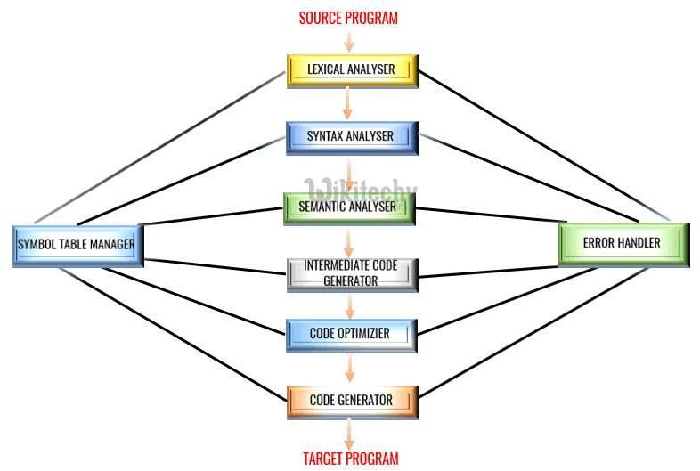
Phases of Compiler

Slide 45

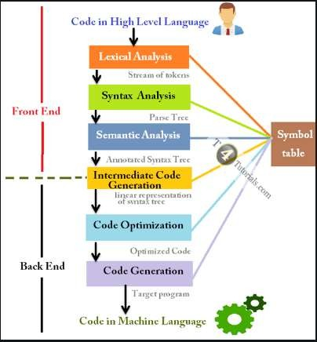
Example : https://youtu.be/P1bQUyl t0
PHASESOFCOMPILER

Slide 46
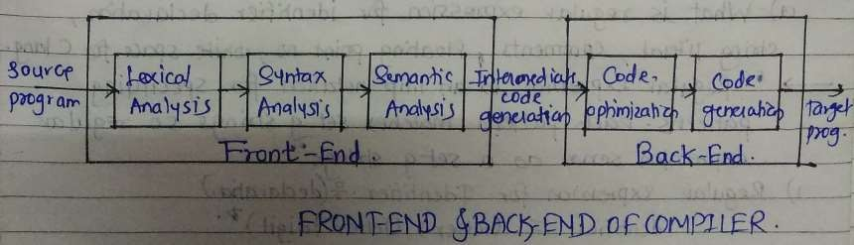
Example : https://youtu.be/P1bQUyl t0
C
FRONTEND& BACKENDOF COMPILER

Slide 47
Phases of Compiler
Lexical Analysis :
Lexical analyzer phase is the first phase of compilation process. It takes source code as input. It reads the source program one character at a time and converts it into meaningful lexemes. Lexical analyzer represents these lexemes in the form of tokens.
Syntax Analysis :
Syntax analysis is the second phase of compilation process. It takes tokens as input and generates a parse tree as output. In syntax analysis phase, the parser checks that the expression made by the tokens is syntactically correct or not.

Slide 48
Phases of Compiler
Semantic Analysis :
Semantic analysis is the third phase of compilation process. It checks whether the parse tree follows the rules of language. Semantic analyzer keeps track of identifiers, their types and expressions. The output of semantic analysis phase is the annotated tree syntax.
Intermediate Code Generation :
In the intermediate code generation, compiler generates the source code into the intermediate code. Intermediate code is generated between the high-level language and the machine language. The intermediate code should be generated in such a way that you can easily translate it into the target machine code.

Slide 49
Phases of Compiler
Code Optimization :
Code optimization is an optional phase. It is used to improve the intermediate code so that the output of the program could run faster and take less space. It removes the unnecessary lines of the code and arranges the sequence of statements in order to speed up the program execution.
Code Generation :
Code generation is the final stage of the compilation process. It takes the optimized intermediate code as input and maps it to the target machine language. Code generator translates the intermediate code into the machine code of the specified computer.

Slide 50
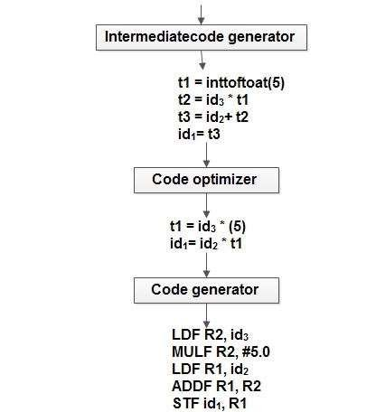
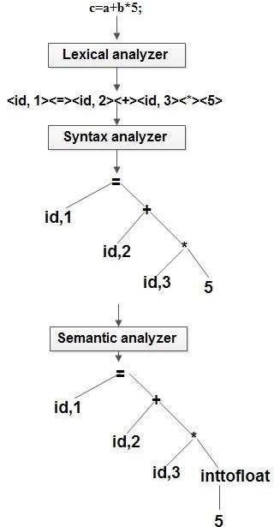
Example :

Slide 51









INTERPRTERS
rpretation”
– Performing the operations implied by the source program
• “Inte
Source Program
Interpreter
Output
Input
Error Messages
5
2

Slide 52
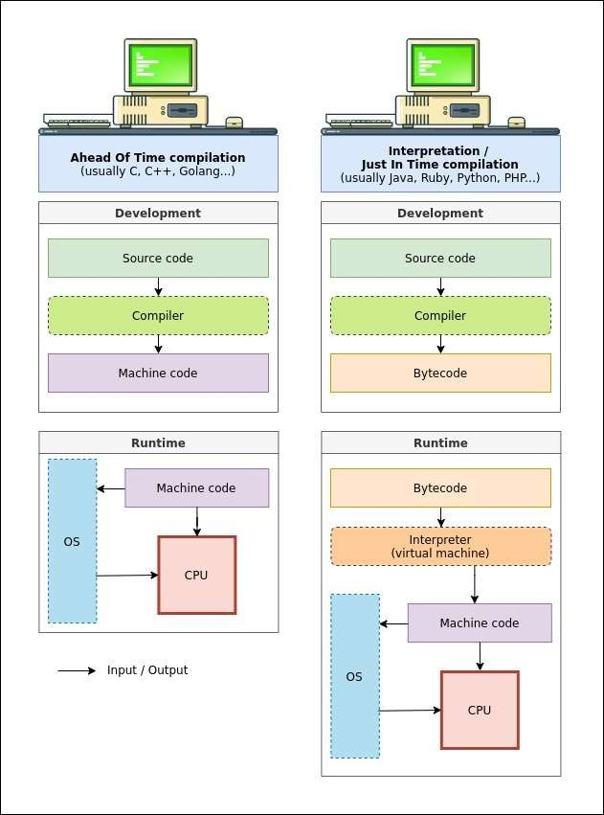

Slide 53
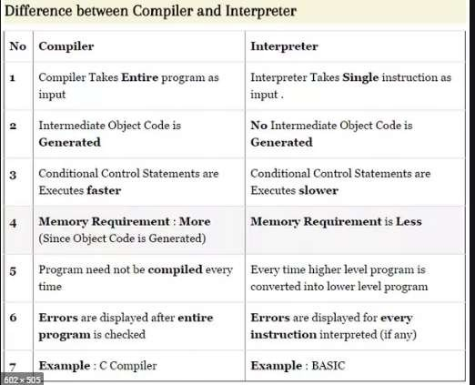

Slide 54
Debugger
Debugging tool helps programmer for testing and debugging programs.
It provides some facilities:
Setting breakpoints.
Displaying values of variables.

Slide 55
Device driver
Debugging tool helps programmer for testing and debugging programs.
It provides some facilities:
Setting breakpoints.
Displaying values of variables.

Slide 56
Operating system
It is system software which provides interface between user and hardware(computer system)

Slide 57
Assembly Language

Slide 58
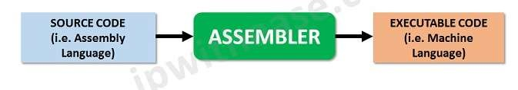
ASSEMBLY LANGUAGE PROGRAMMING

Slide 59
Assembly Language
Assembly language is low level language.
An assembly language is machine dependent.
It differs from computer to computer.
Writing programs in assembly language is very easy as compared to machine(binary) language.

Slide 60
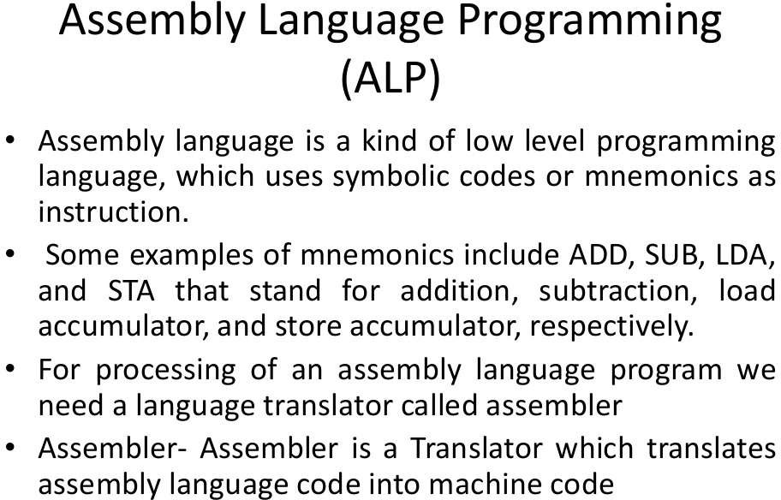

Slide 61
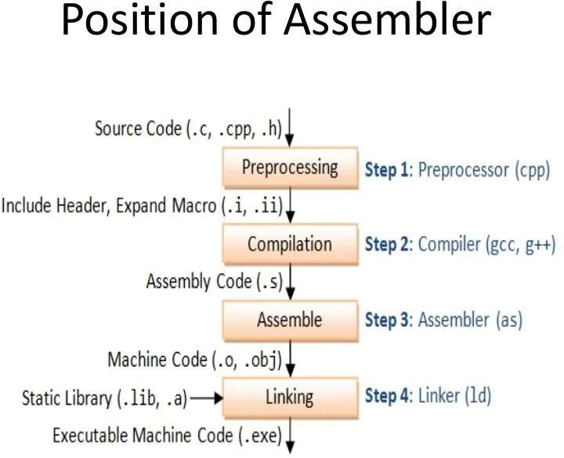

Slide 62
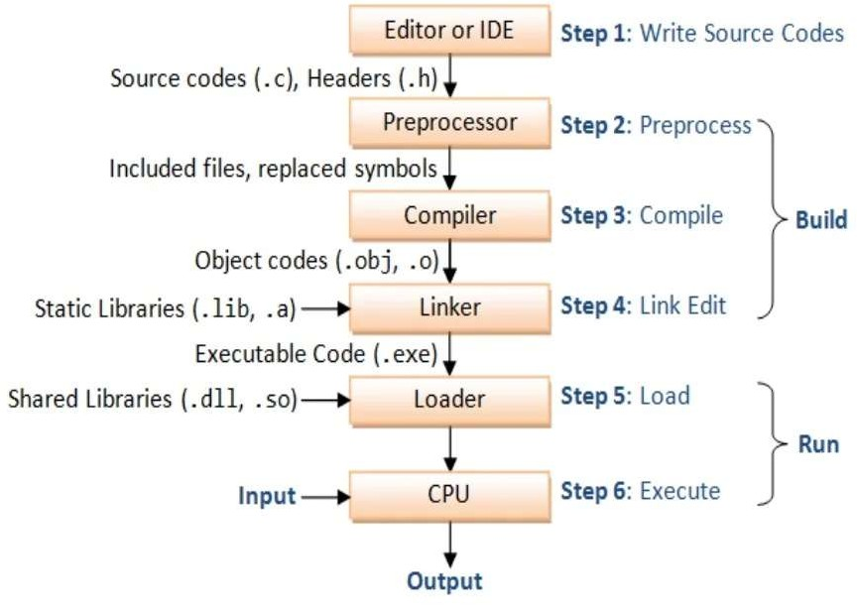

Slide 63
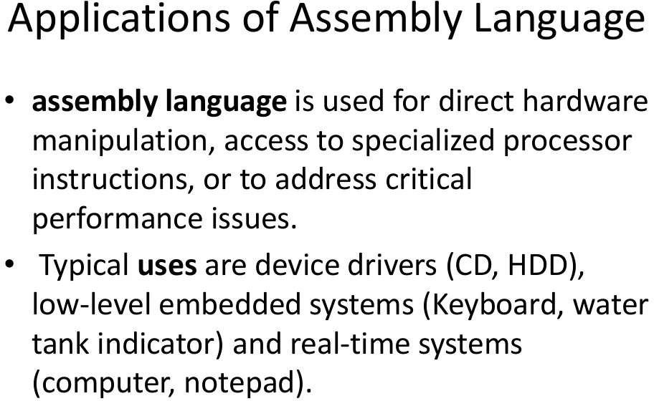

Slide 64
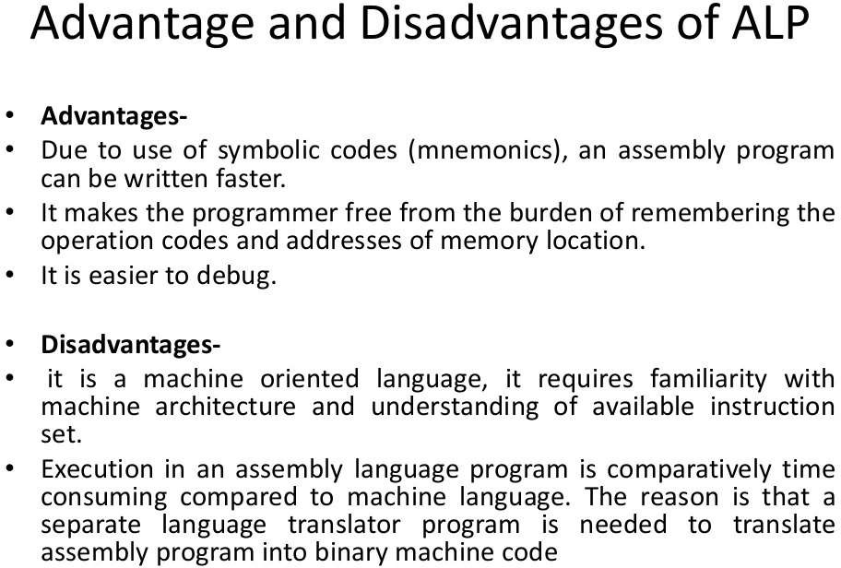

Slide 65
Machine Instruction in Assembly Language
Machine Instructions are commands or programs written in machine code of a machine (computer) that it can recognize and execute.
A machine instruction consists of several bytes in memory that tells the processor to perform one machine operation.
The processor looks at machine instructions in main memory one after another, and performs one machine operation for each machine instruction.
The collection of machine instructions in main memory is called a machine language progr^{M}a^{R}m. .^{ANAND GHARU}

Slide 66
Machine Instruction in Assembly Language
The general format of a machine instruction is
[Label:] Mnemonic [Operand, Operand] [; Comments]
Brackets indicate that a field is optional
Label is an identifier that is assigned the address of the first byte of the instruction in which it appears. It must be followed by “:”
Inclusion of spaces is arbitrary, except that at least one space must be inserted; no space would lead to an ambiguity.
Comment field begins with a semicolon “ ; ”
Example:
Here: MOV R5,#25H;
load 25H into R5

Slide 67
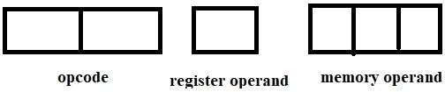
Machine instruction Format:

Slide 68
Assembly language programming Terms:
Location Counter: (LC) points to the next instruction.
Literals: constant values
Symbols: name of variables and labels
Procedures: methods/ functions

Slide 69
Assembly language Statements:
Imperative Statements:
Declarative/Declaration Statements:
Assembler Directive:

Slide 70
Imperative Statements
Imperative means mnemonics
These are executable statements.
Each imperative statement indicates an action to be taken during execution of the program.
E.g
MOVER BREG, X STOP
READ X
^{ADD ARE}MR^{G}. ,AN^{Z}AND GHARU
.

Slide 71
Declarative Statements
Declaration statements are for reserving memory for variables.
We can specify the initial value of a variable.
It has two types:
DS // Declare Storage
DC // Declare Constant

Slide 72
DS(Declare Storage):
Syntax:
[Label]
E.g.
DS <Constant specifying size> X DS 1
DC (Declare Constant):
Syntax:
[Label ]
E.g Y
DC <constant specifying value> DC ‘5’

Slide 73
Assembler Directive
Assembler directive instruct the assembler to perform certain actions during assembly of a program.
Some assembler directive are:
START <address constant>
END

Slide 74
Advanced Assembler Directives
1. ORIGIN
2. EQU
3. LTORG

Slide 75
Sample Assembly Code
1. START 100
It is an AD statement because it has Assembler directive START
MOVER AREG, X
MOVER BREG, Y
ADD AREG, Y
MOVEM AREG, X
It is an IS because it starts with mnemonic.
X DC ‘10’
Y DS 1
END
It is an DS/ DL statement because it has DC It is an DS/ DL statement because it has DS

Slide 76
Identify the types of
State.No | IS | DS | AD
1
2
3
4
5
6
7
8 | MR. | ANAND GHARU
sta
tements

Slide 77
Identify the types of
State.No | IS | DS | AD
1 |  |  | AD
2 | IS
3 | IS
4 | IS
5 | IS
6 |  | DS
7 |  | DS
8 | MR. | ANAND GHARU | AD
sta
tements

Slide 78
Advanced Assembler Directives
ORIGIN
EQU
LTORG

Slide 79
Advanced Assembler Directives
Origin :
The origin directive tells the assembler where to load instructions and data into memory.
SYNTAX :
ORIGIN

Slide 80
Advanced Assembler Directives
Equate:
The EQU directive is used to equate a name with an expression, symbolic address,
or number. Whenever this name is used as a symbol, it is replaced.
We might do something, such as the following, which makes the symbol R12 to be equal to 12, and replaced by that value when the assembler is run.
E.G. R12 EQU 12

Slide 81
Advanced Assembler Directives
LTORG :
The LTORG directive instructs the assembler to assemble the current literal pool immediately.
The Literal Pool contains a collection of anonymous constant definitions, which are generated by the assembler.
The LTORG directive defines the start of a literal pool.
Syntax :
LTORG

Slide 82
How LC Operates?
Sr. NO |  | LC
1 | START 100
2 | MOVER AREG, X
3 | MOVER BREG, Y
4 | ADD AREG, BREG
5 | MOVEM AREG, X
6 | X DC ‘10’
7 | Y DC ‘15’
8 | END

Slide 83
How LC Operates?
Sr. NO |  | LC
1 | START 100
2 | MOVER AREG, X | 100
3 | MOVER BREG, Y | 101
4 | ADD AREG, BREG | 102
5 | MOVEM AREG, X | 103
6 | X DC ‘10’ | 104
7 | Y DC ‘15’ | 105
8 | END

Slide 84
Identify symbol, literals, AD, DS, IS ,
Symbol, Literal Label
START 100
MOVER BREG, =‘2’
LOOP MOVER AREG, N
ADD BREG, =‘1’
ORIGIN LOOP+5
LTORG
ORIGIN NEXT +2
LAST STOP
N DC ‘5’
END

Slide 85
Solution (From Previous Example)
Sr. No | AD | DS | IS | Symb ol | Literal | Label
1 | AD
2 |  |  | IS |  | =2
3 |  |  | IS | N |  | LOOP
4 |  |  | IS |  | =1
5 | AD
6 | AD
7 | AD
8 |  |  | IS |  |  | LAST
9 |  | DS
10 | AD | MR. AN | AND GHA | RU

Slide 86
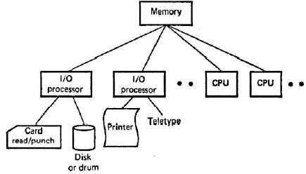
Machine Structure

Slide 87
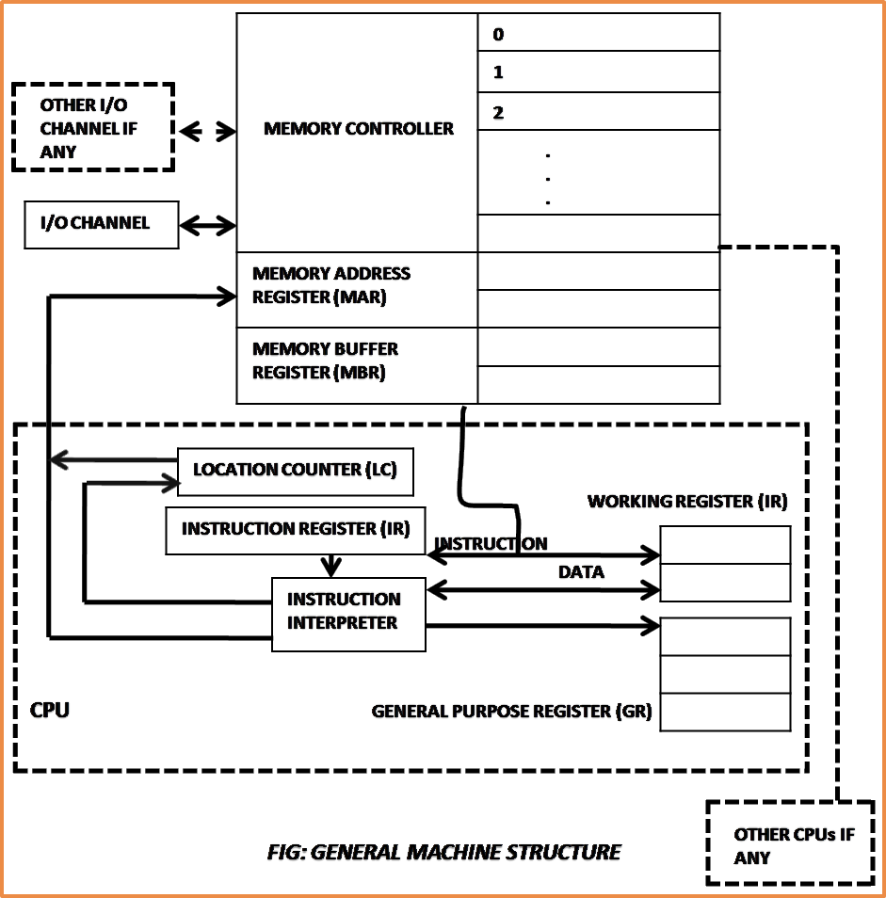
Machine Structure

Slide 88
Consider any hypothetical assembly language.
It supports three registers:
AREG
BREG
CREG

Slide 89
Machine instruction Format:

Slide 90
OPERATIONS.
It supports 11
STOP
ADD
SUB
MULT
MOVER
MOVEM
COMP
BC
DIV
READ
PRINT
different

Slide 91
In this hypothetical machine,
First operand is always a CPU register.
Second operand is always memory operand.
READ and PRINT instructions do not use
first operand.
The STOP instruction has no operand.

Slide 92
Each symbolic opcode is associated with machine opcode.
These details are stored in machine opcode table(MOT).
MOT contains:
1. Opcode in mneonic form
2. Machine code associated with the opcode.

Slide 93
Symbolic Opcode | Machine Code for opcode | Size of instruction (in number of words)
STOP | 00 | 1
ADD | 01 | 1
SUB | 02 | 1
MULT | 03 | 1
MOVER | 04 | 1
MOVEM | 05 | 1
COMP | 06 | 1
BC | 07 | 1
DIV | 08 | 1
READ | 09 | 1
PRINT | 10 | 1

Slide 94
Symbolic Opcode | Machine Code for opcode
START | 01
END | 02
LTORG | 03
ORIGIN | 04
EQU | 05

Slide 95
Sr. NO | Declarative Statement | Machine Opcode
01 | DS | 01
02 | DC | 02

Slide 96
Sr. No | Symbolic opcode | Machine opcode
1 | AREG | 01
2 | BREG | 02
3 | CREG | 03

Slide 97
ASSEMBLER
An assembly language program can be translated into machine language.
It involves following steps:
1. Find addresses of variable.
2. Replace symbolic addresses by numeric addresses.
3. Replace symbolic opcodes by machine operation codes.
4. Reserve storage for data.

Slide 98
Step 1
We can find out addresses of variable using LC.
First identify all variables in your program.
START 100
MOVER
MOVER
ADD AREG, X
MOVEM AREG, X
X DC ‘10’
Y DC ‘15’
END
AREG, X BREG, Y

Slide 99
Step 1
Sr. NO |  | LC
1 | START 100
2 | MOVER AREG, X | 100
3 | MOVER BREG, Y | 101
4 | ADD AREG, X | 102
5 | MOVEM AREG, X | 103
6 | X DC ‘10’ | 104
7 | Y DC ‘15’ | 105
8 | END

Slide 100
Sr. No | Name of Variable(Symbol) | Address
1 | X | 104
2 | Y | 105

Slide 101
Step2: Replace all symbolic address with numeric address.
START 100
MOVER AREG, 104
MOVER BREG, 105
ADD AREG, 104
MOVEM AREG, 104
X DC ‘10’
Y DC ‘15’
END
Memory is reserved but no code is generated.

Slide 102
Step3: Replace symbolic opcodes by machine operation codes.
LC | Assembly Instruction | Machine Code
101 | MOVER AREG, 104 | 04 01 104
102 | MOVER BREG, 105 | 04 02 105
103 | ADD AREG, 104 | 01 01 104
104 | MOVEM AREG, 104 | 05 01 104
105
106
107

Slide 103
Question For U
START 102 READ X READ Y
MOVER AREG, X ADD AREG, Y
MOVEM AREG, RESULT PRINT RESULT
STOP X DS 1
Y DS 1
RESULT DS 1 END

Slide 104
Question For u
START 101 READ N
MOVER BREG, ONE MOVEM BREG, TERM MULT BREG, TERM MOVER CREG, TERM ADD CREG, ONE MOVEM CREG, TERM COMP CREG, N
BC LE, AGAIN
MOVEM BREG, RESULT PRINT RESULT
STOP N DS 1
RESULT DS 1
ONE DC ‘1’
TERM DS 1
AGAIN

Slide 105
Assembler
An Assembler is a translator which translates assembly language code into machine language with help of data structure.
It has two types
Pass 1 Assembler.
Pass 2 Assembler.

Slide 106
General design procedure of assembler
Statement of Problem
Data Structure
Format of databases
Algorithms
Look for modularity.

Slide 107
Statement of Problem
We want to convert assembly language program into machine language.

Slide 108
Data Structure Used
Data Structure used are as follows:
Symbol table
Literal Table
Mnemonic Opcode Table
Pool Table

Slide 109
Format of Databases
Symbol Table:
Name of Symbol | address
Literal Table:
Literal | address

Slide 110
MOT:
Mnemonic | Machine Opcode | Class | Length
Pool Table:
Literal Number

Slide 111
Forward Reference Problem
Using a variable before its definition is called as forward reference problem.
E.g.
START 100
MOVEM AREG, X
MOVER BREG, Y
ADD AREG, Y
X DC ‘4’
Y DC ‘5’
END

Slide 112
In example variable X, Y are making forward reference.
So, We can solve it by using back patching.

Slide 113
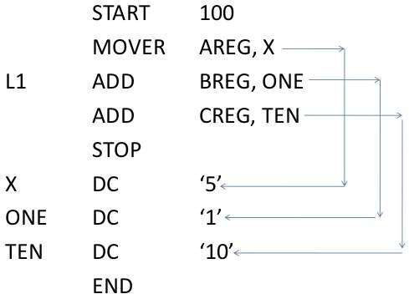
Consider another example

Slide 114
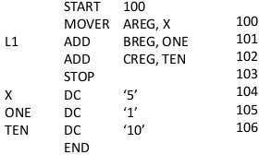
Apply LC

Slide 115
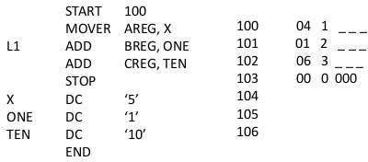
Try to convert into machine code

Slide 116
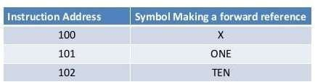
Backpatching
The operand field of instruction containing a forward reference is left blank initially.
Step 1: Construct TII(Table of incomplete instruction)

Slide 117
Step 2 : After encountering END statement symbol table would contain the address of all symbols defined in the source program.
SYMBOL NAME | ADDRESS
X | 104
ONE | 105
TEN | 106

Slide 118
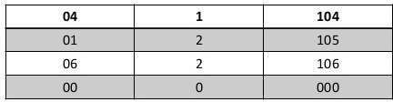
Now we can generate machine code…
01
03

Slide 119
Pass 1 Assembler
Pass 1 assembler separate the labels , mnemonic opcode table, and operand fields.
Determine storage requirement for every assembly language statement and update the location counter.
Build the symbol table. Symbol table is used to store each label and each variable and its corresponding address.
Pass 2 Assembler: Generate the machine code

Slide 120
How pass 1 assembler works?
Pass I uses following data structures.
1. Machine opcode table.(MOT)
2. Symbol Table(ST)
3. Literal Table(LT)
4. Pool Table(PT)
Contents of MOT are fixed for an assembler.

Slide 121
Observe Following Program
START 200
MOVER AREG, =‘5’ MOVEM AREG, X
L1 MOVER BREG, =‘2’ ORIGIN L1+3 LTORG
NEXT
ADD AREG, =‘1’
SUB BREG, =‘2’ BC LT, BACK LTORG
BACK EQU L1 ORIGIN NEXT+5 MULT CREG, =‘4’ STOP
X DS 1 END

Slide 122
Apply LC
START 200
MOVER AREG, =‘5’
MOVEM AREG, X
L1 MOVER BREG, =‘2’ ORIGIN L1+3 LTORG
=‘5’
=‘2’
200
201
202
205
206
NEXT
ADD AREG, =‘1’
SUB BREG, =‘2’
BC LT, BACK LTORG
207
208
209
=‘1’
=‘2’
210
211
BACK
EQU L1
ORIGIN NEXT+5
MULT CREG, =‘4’ | 212
STOP | 213
X DS 1 END | 214
=‘4’

Slide 123
Construct Symbol table
index | Symbol Name | Address
0 | X | 214
1 | L1 | 202
2 | NEXT | 207
3 | BACK | 202

Slide 124
Construct Literal Table
index | Literal | Address
0 | 5 | 205
1 | 2 | 206
2 | 1 | 210
3 | 2 | 211
4 | 4 | 215

Slide 125
Pool Table.
Pool table contains starting literal(index ) of each pool.
Literal number
0
2
4

Slide 126
NOW CONSTRUCT INTERMEDIATE CODE/MACHINE CODE
For constructing intermediate code we need MOT.

Slide 127
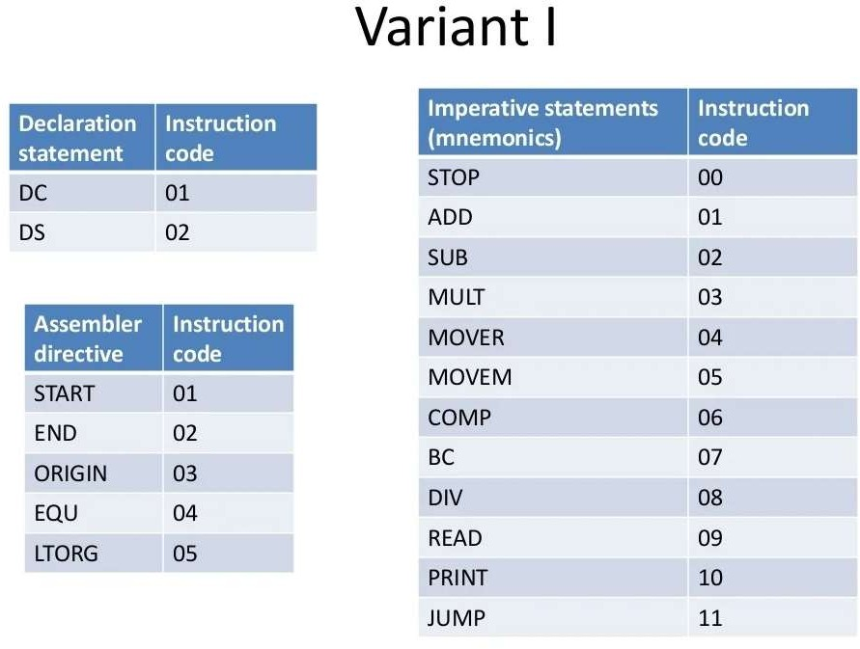

Slide 128
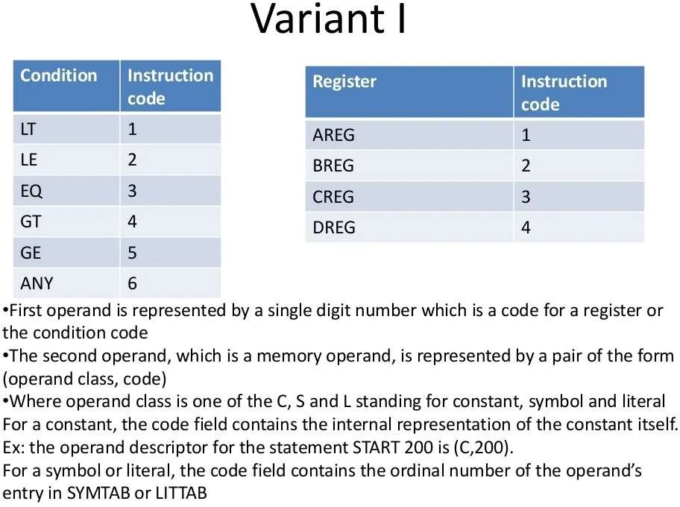

Slide 129
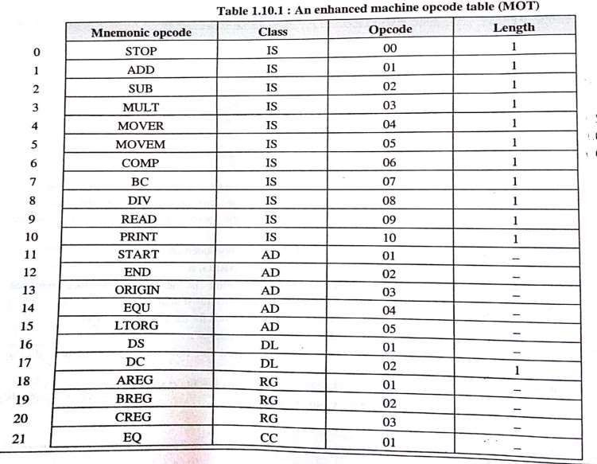
Enhanced Machine opcode Table

Slide 130
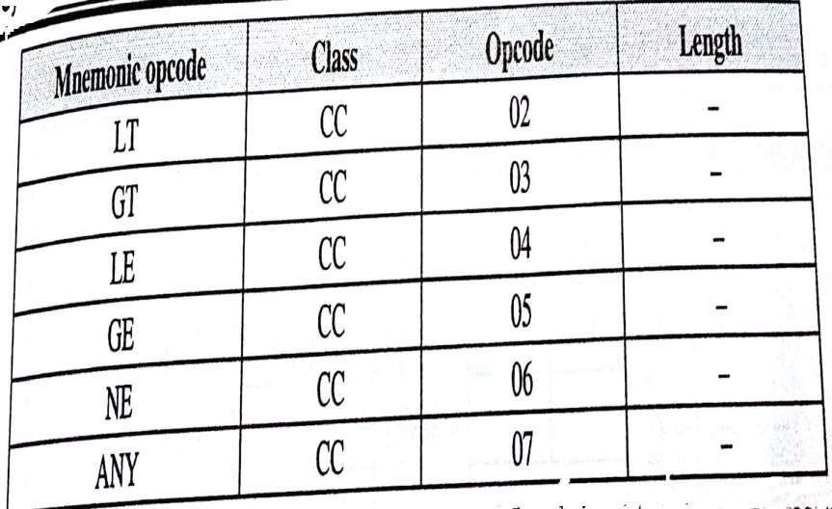

Slide 131
Example No.2
START 205
MOVER AREG, =‘6’ MOVEM AREG, A MOVER AREG, A MOVER CREG, B ADD CREG, =‘2’ BC ANY , NEXT LTORG
ADD BREG, B SUB AREG, =‘1’ BC LT, BACK STOP
ORIGIN LOOP+2 MULT CREG, B
ORIGIN LAST+1
LOOP
NEXT
LAST
A BACK B END
DS EQU DS
1
LOOP
1

Slide 132
PASS 2 assembler requires two scans of program to generate machine code.
It uses data structures defined by pass 1. like symbol table, MOT, LT.

Slide 133
Design of two pass assembler
Tasks performed by the passes of a two pass assembler are as follows:
Pass 1:
Separate the symbol, mnemonic opcode, and operand fields.
Build the symbol table.
Perform LC processing.
Construct intermediate representation(or IC).
Pass 2:
1. Synthesize the target program.

Slide 134
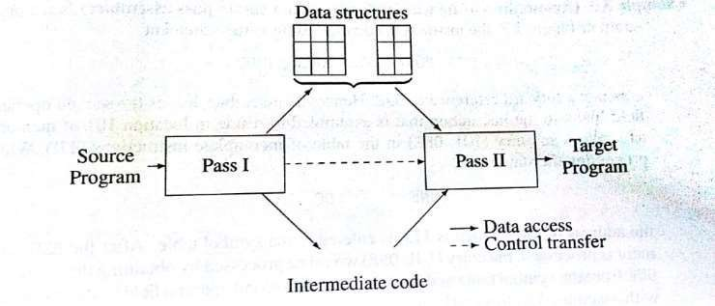
Two Pass Assembler

Slide 135
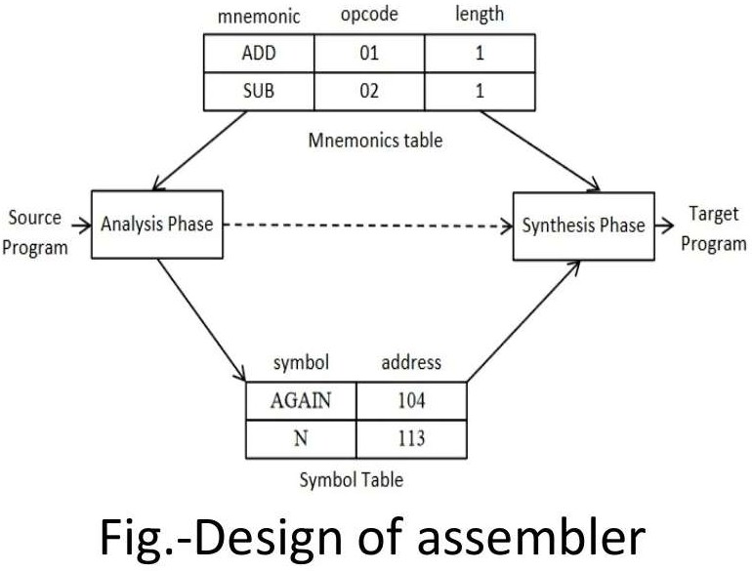
Analysis Phase Vs. Synthesis Phase

Slide 136
Comparison between Pass 1 and Pass2
Sr. No | Pass 1 | Pass 2
01 | It requires only one scan to generate machine code | It requires two scan to generate machine code.
02 | It has forward reference problem. | It don’t have forward reference problem.
03 | It performs analysis of source program and synthesis of the intermediate code. | It process the IC to synthesize the target program.
04 | It is faster than pass 2. | It is slow as compared to pass 1.

Slide 137
Pass 1 output and pass 2 output
Pass 1 assembler generates Intermediate code.
Pass 2 assembler generates Machine code.

Slide 138
INTERMEDIATE CODE

Slide 139
INTERMEDIATE CODE
Format for intermediate code:
For every line of assembly statement, one line of intermediate code is generated.
Each mnemonic field is represented as
(statement class, and machine code)

Slide 140
Statement class can be:
1. IS
2. DL/DS
3. AD

Slide 141
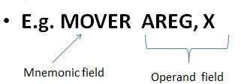
So, IC for mnemonic field of above line is,
(statement class, machine code)
(IS, 04) …………………from MOT

Slide 142
Operand Field:
Each operand field is represented as
(operand class, reference)
The operand class can be:
1. C: Constant
2. S: Symbol
3. L: Literal
4. RG: Register
5. CC: Condition cod^{M}e^{R}s^{. ANAND GHARU}

Slide 143
E.g. MOVER AREG, X
For a symbol or literal the reference field contains the index of the operands entry in symbol table or literal table.
•
So IC for above line is:
(IS, 04) (RG, 01) (S, 0)

Slide 144
For example…
START 200
IC: (AD, 01) (C, 200)

Slide 145
Consider following example
START 200
 | MOVER AREG, =‘5’ | 200
 | MOVEM AREG, X | 201
L1 | MOVER BREG, =‘2’ | 202
 | ORIGIN L1+3
 | LTORG
 | =‘5’ | 205
 | =‘2’ | 206
NEXT | ADD AREG, =‘1’ | 207
 | SUB BREG, =‘2’ | 208
 | BC LT, BACK | 209
 | LTORG
 | =‘1’ | 210
 | =‘2’ | 211
BACK | EQU L1
 | ORIGIN NEXT+5
 | MULT CREG, =‘4’ | 212
 | STOP | 213
 | X DS 1 | 214
 | END
=‘4’

Slide 146
Symbol Table and Literal Table
index | Symbol Name | Address
0 | X | 214
1 | L1 | 202
2 | NEXT | 207
3 | BACK | 202
•
index | Literal | Address
0 | 5 | 205
1 | 2 | 206
2 | 1 | 210
3 | 2 | 211
4

Slide 147
Intermediate Code
(AD, 01) (C, 200)
200 (IS, 04) (RG,01) (L, 0)
201 (IS, 05) (RG,01) (S,0)
202 (IS, 04) (RG,02) (L,1)
203 (AD, 03) (C, 205)
205 (DL, 02) (C,5)
206 (DL, 02) (C, 2)
207 (IS,01) (RG, 01) (L, 2)

Slide 148
208 (IS, 02) (RG, 02) (L,3)
209 (IS, 07) (CC, 02) (S, 3)
210 (DL,02) (C,1)
211 (DL,02) (C,2)
212 (AD, 04) (C, 202)
212 (AD, 03) (C, 212)
212 (IS, 03) (RG, 03)(L, 4)
213 (IS, 00)

Slide 149
214 (DL, 01, C, 1)
215 (AD, 02)
215 (DL, 02) (C,4)

Slide 150
Intermediate Code and Machine code
I.C | LC | Machine Code
(AD, 01) (C, 200)
(IS, 04) (RG,01) (L, 0) | 200 | 04 01 205
(IS, 05) (RG,01) (S,0) | 201 | 05 01 214
(IS, 04) (RG,02) (L,1) | 202 | 04 02 206
(AD, 03) (C, 205) | 203
(DL, 02) (C,5) | 205 | 00 00 005
(DL, 02) (C, 2) | 206 | 00 00 002
(IS,01) (RG, 01) (L, 2) | 207 . | 01 01 210

Slide 151
I.C | LC | Machine Code
(IS, 02) (RG, 02) (L,3) | 208 | 02 02 211
(IS, 07) (CC, 02) (S, 3) | 209 | 07 02 202
(DL,02) (C,1) | 210 | 00 00 001
(DL,02) (C,2) | 211 | 00 00 002
(AD, 04) (C, 202) | 212
(AD, 03) (C, 212) | 212
(IS, 03) (RG, 03)(L, 4) | 212 | 03 03 215
(IS, 00) | 213 | 00 00 000

Slide 152
I.C | LC | Machine Code
(DL, 01, C, 1) | 214
(AD, 02) | 215
(DL, 02) (C,4) | 215 | 00 00 004

Slide 153
Variants of Intermediate Code.
There are two variants of I.C.:
Variant I
Variant II.

Slide 154
Variant I
In Variant I, each operand is represented by a pair of the form (operand class, code).
The operand class is one of:
1. S for symbol 2. L for literal
3. C for constant 4. RG for register.

Slide 155
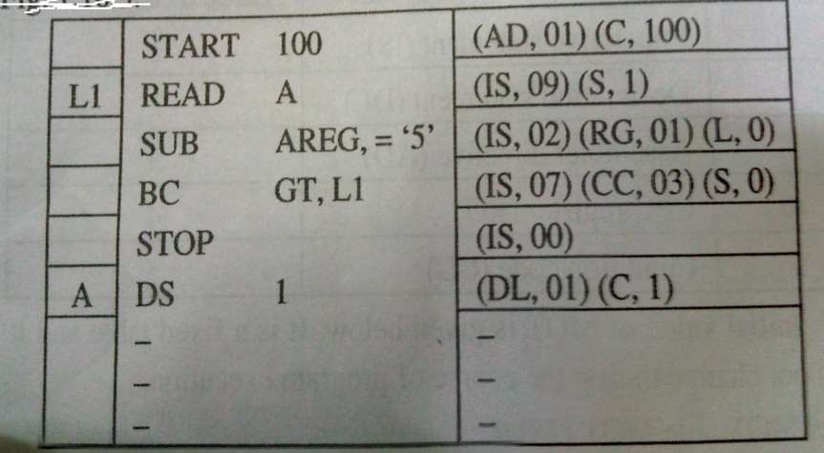
Variant
I

Slide 156
Variant II
In variant II, operands are processed selectively.
Constants and literals are processed. Symbols, condition codes and CPU registers are not processed.

Slide 157
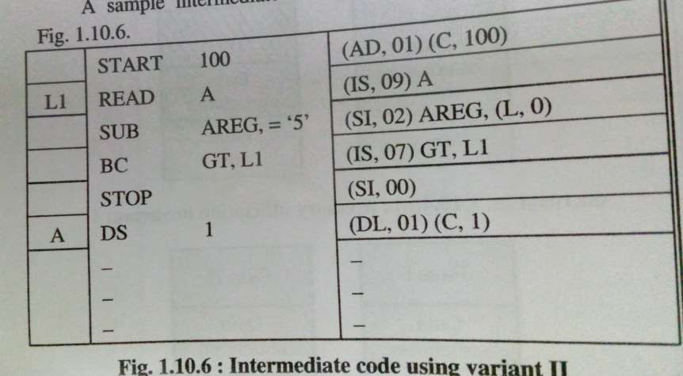
Variant II

Slide 158
Error Reporting
An assembly program may contain errors.
It may be necessary to report these errors effectively.
Some errors can be reported at the end of the source program.
Some of the typical programs include:
Syntax errors like missing commas…
Invalid opcode
Duplicate definition of a symbol.
Undefined symbol
Missing START statement.

Slide 159
Example
START 100
MOVER AREG, X
ADDER BREG, X
ADD AREG, Y
X DC ‘2’
X DC ‘3’
Z DC ‘3’
END

Slide 160
START 100
MOVER AREG, X
ADDER BREG, X
ADD AREG, Y
X DC ‘2’
Invalid opcode
Undefined symbol Y
X DC ‘3’
Z DC ‘3’
END
duplicate definition of Symbol X.

Slide 161

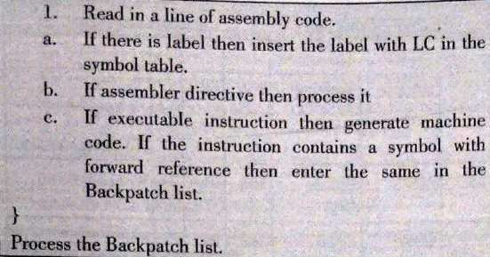
PASS-1 OF TWO PASS ASSEMBLER
NOTE : Draw pass-1 and pass-2 algorithm and flowchart in your own un_{M}d_{R}e.r_{A}s_{N}ta_{AN}n_{D}di_{G}n_{H}g_{A}._{RU}

Slide 162
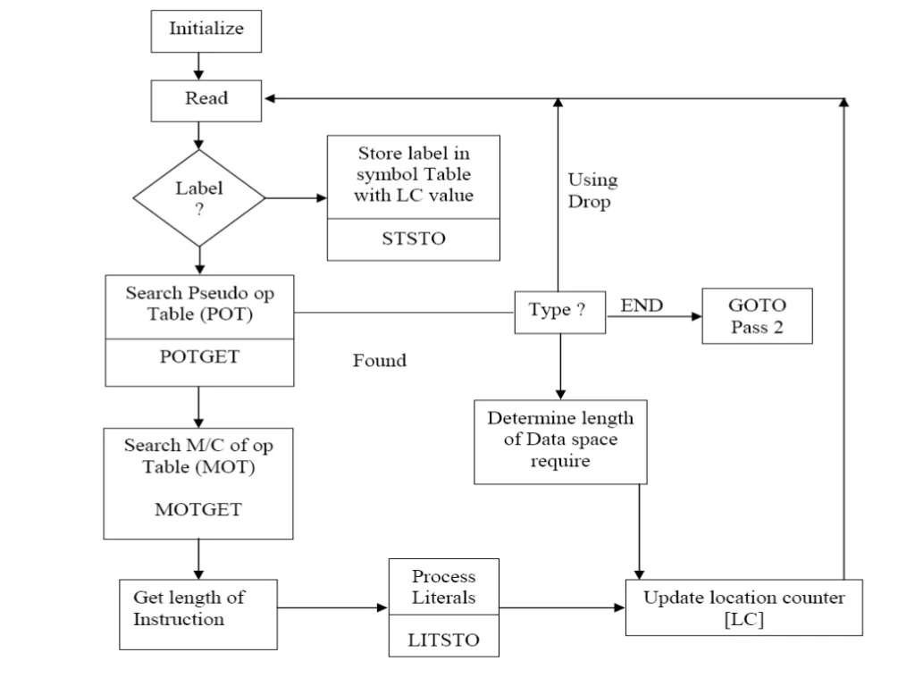
PASS-1 OF TWO PASS ASSEMBLER

Slide 163
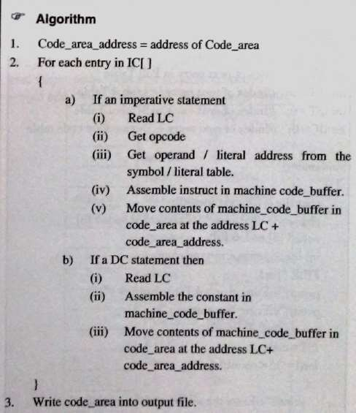
PASS-2 OF TWO PASS ASSEMBLER

Slide 164

PASS-2 OF TWO PASS ASSEMBLER

